Slide 1


DEPARTMENT OF PHYSICS AND NANOTECHNOLOGY
SRM INSTITUTE OF SCIENCE AND TECHNOLOGY
18PYB103J –Semiconduuctor Physics
Lecture S4
Dr. V. Ganesh
18PYB101J Module-I

Slide 2

1. A semiconductor diode laser has a peak emission wavelength of 1.55 μm. Find its band gap in eV.
Sol: Energy gap of semiconductor, Eg = energy of emitted photon, hν
images where c = velocity of light = 3 × 108 m/s
Wavelength, λ = 1.55 μm = 1.55 × 16-6 m
Energy gap, Eg = ?
18PYB101J Module-I

Slide 3
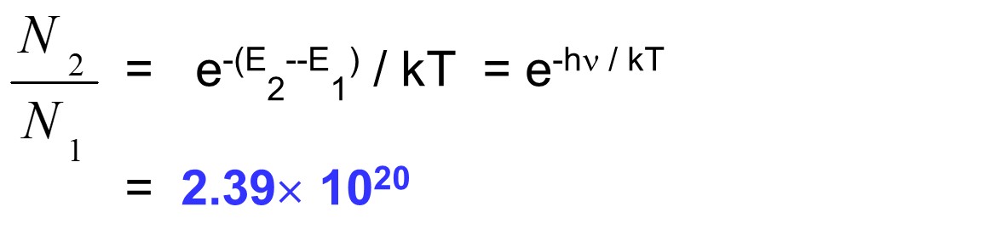
Find the relative population of the two states in Nd:YAG laser that produces a light beam of wavelength 1.06μm at 300K.
18PYB101J Module-I

Slide 4
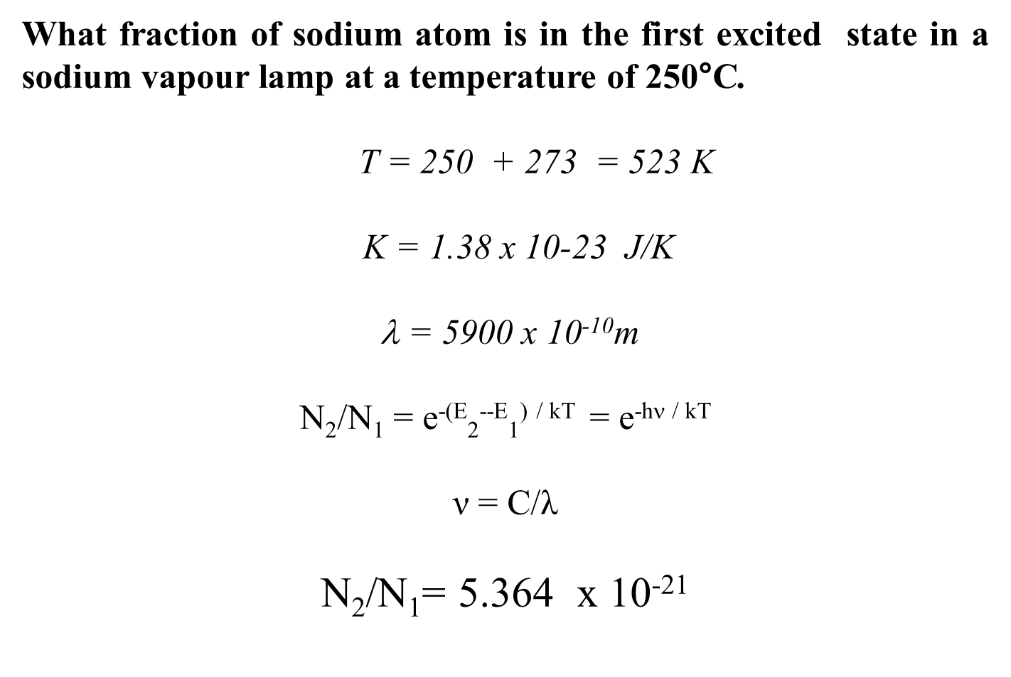
18PYB101J Module-I

Slide 5
A He-Ne laser emits light at a wavelength of 632.8nm and has an output power of 3.2 mw. How many photons are emitted in each minute by this laser when operating?
= 6328 x 10⁻¹⁰m P = 3.2 mw = 3.2 x 10⁻³ w
= c/λ = 4.74 x 10¹⁴ Hz
E = hν = 3.14 x 10⁻¹⁹ J
P = nE
n= P/E = 0.95 X 10¹⁶
Photons /minute = n x 60
6.11 x 10¹⁷ photons / minute.
18PYB101J Module-I

Slide 6
1. Calculate the wavelength of emitted radiation from GaAs which has a band gap of 1.44 eV.
2. Determine the maximum wavelength λ of a light source that can generate electron–hole pairs in (a) Si, (b) Ge, (c) GaAs, and (d ) InP
18PYB101J Module-I

